Slide 1
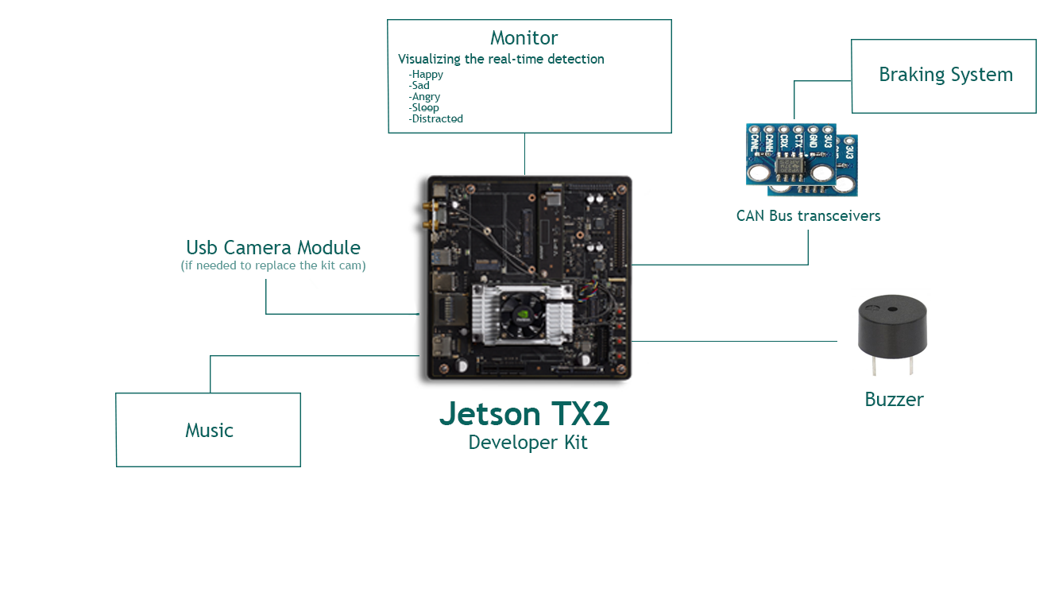
Hardware
( Purchase Link )
( Purchase Link )

Slide 2



Platform
Tensorflow Keras OpenCV

Slide 3
Datasets
Facial Expression Recognition:
Fer2013 dataset
Google facial expression comparison dataset
AffectNet dataset(requested)
Driver Distraction Detection:
AUC Distracted Driver dataset
Create new frontal face distracted dataset
Driver Drowsiness Detection:
YawDD dataset
NTHU-DDD dataset
CEW dataset
Create new frontal face sleeping dataset

Slide 4
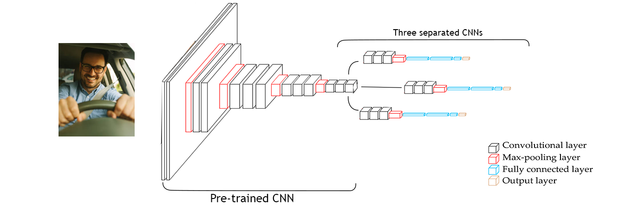
Architecture
Frontal face Concept 1:

Slide 5
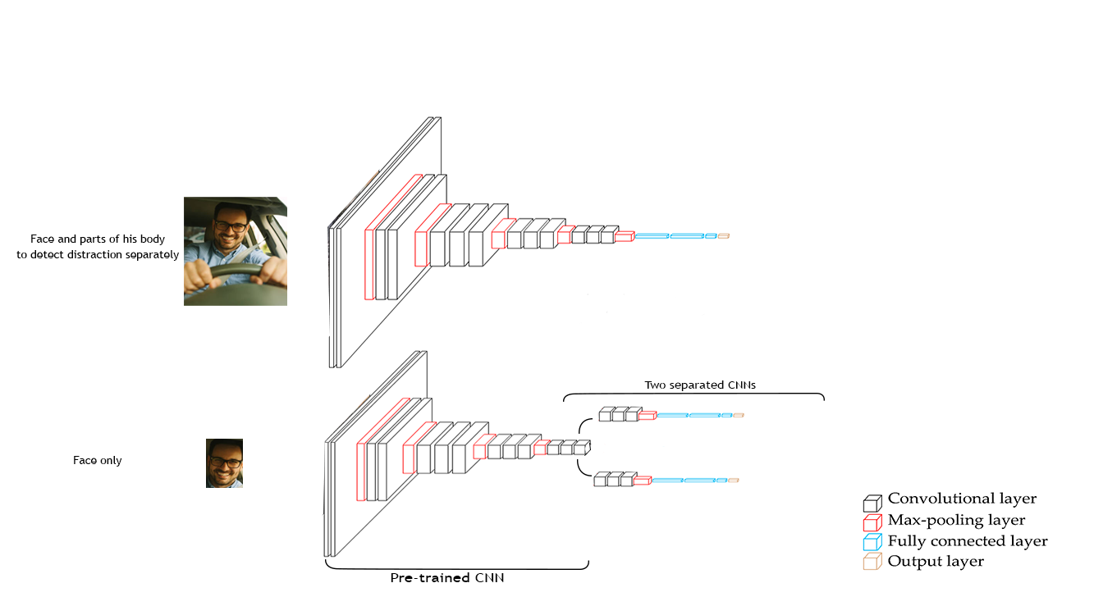
Architecture
Frontal face Concept 2:

